Slide 1





HOLY MARY INSTITUTE OF TECHNOLOGY & SCIENCE (Approved by AICTE, New Delhi, Affiliated to JNTU, Hyderabad)
BOGARAM(V),KEESARA(M),MEDCHAL DISTRICT-501301
2021-2022
DEPARTMENT OF COMPUTER SCIENCE ENGINEERING
RECETTE
Recipes, pantry manager, meal plans and more!
By:
K.SHASHANK(18C91A0547)
G.VISHNU (18C91A0530)
K.RASHMITHA(18C91A0538)
Under the guidance of:
Ms N.MOUNIKA

Slide 2
ABSTRACT
The use of mobile devices have increased significantly in the past decade. All these devices use applications that are created for them.
This paper presents a food recipe cross-platform application that helps users find and view different food recipes based on different categories, as well as allowing them to search recipes of their comfort using smart search-filters and categories.
The users can filter the list of recipes based on the ingredients used in the recipe, the prep time, cook time, and diet.
The app aspires to run efficiently, while having an elegant ux with essential functionalities that of an online application and yet remaining completely offline.

Slide 3
EXISTING SYATEM
Surely there are many recipe apps that offer wide varieties of options to choose from, but most of them are online only and those that are offline lack either that multi-tude of options and devoid of proper UX and structure.

Slide 4
DISADVANTAGES OF EXISTING SYSTEM
Constant internet connectivity.
Lack of categorization, variety and content.
Mediocre UX/UI in offline apps
Fewer features compared to their online counterparts

Slide 5
PROPOSED SYSTEM
We are developing an application to help people who are having problems with internet, while retaining all the features that makes an online app great and more features than some existing ones.
We are using dart and flutter to develop our native app to both iOS,Android,etc.,.Dart/futter allows devs to developed native apps for multiple platforms from a single code base.

Slide 6




ADVANTAGES OF PROPOSED SYSTEM
Native performance.
Cross-platform, single-code base.
No need of internet.
Huge array of features compared to other offline existing apps.

Slide 7



HARDWARE REQUIREMENTS :
OS : MacOS-64bit and Windows 7 (64bit) or later.
HDD :1.23GB if windows or 2.8GB if MacOS for Flutter sdk.
RAM :4GB(minimum).
Processor :Inter i3 3rdgen or AMD equivalent .
SOFTWARE REQUIREMENTS :
OS : MacOS-64bit and Windows 7 (64bit) or later.
TOOLS : Flutter sdk.
Android Studio/Visual Studio Code or any other IDE supporting dart.
Git.
Windows PowerShell 5.0(only for windows users).

Slide 8
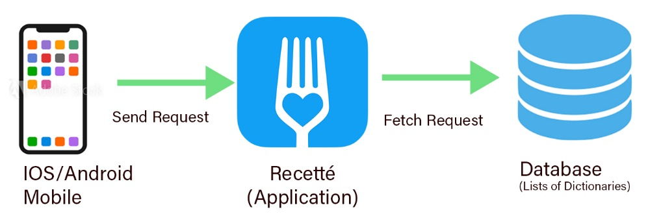
SYSTEM DESIGN

Slide 9
IMPLEMENTATION
The implementation took roughly three months, and involved coding every single day to finally arrive at the final product. The implementation was about designing activities, which are similar to pages in web applications, creating and linking the graphical user interface with the functionalities. Every time we implemented a functionality, we tested it directly on the AVD emulator and my android phone so as to get a real life representation of what the application would look like on our clients’ mobile phones. We also managed to make the mobile application compatible with phones supporting different versions. Further, the mobile application has many features:
Smart search-filters
Categorized view
Curated Collections
Pantry Manager
Meal Planner
Shopping list

Slide 10

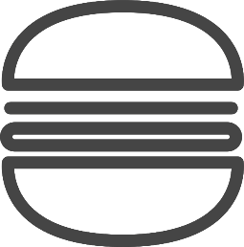

1
Smart search-fiter
Search by name,base-ingredients,diets,.
2
Categorized
Recipies are categorized into cusines,food types,diets,vegan,etc,.
3
Curated collections
Our
Features
Curated recipie collections from famous chefs,web articles,etc.
4
Pantry Manger & Meal Planner
Manage your pantry using our pantry manager
Plan your meals for familly dinner,parties, and other social gatherings.
5
Shopping list
Add recipes to your shopping list and browse required ingredients with a quick glance.
6
Skill guide
Offline wiki on knife skills,cooking techniques,and various other culinary skills including dictionary to better understand common culinay terms

Slide 11
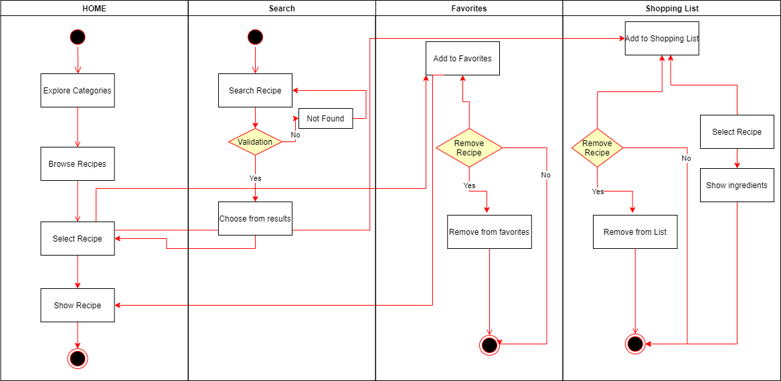
SYSTEM TESTING

Slide 12
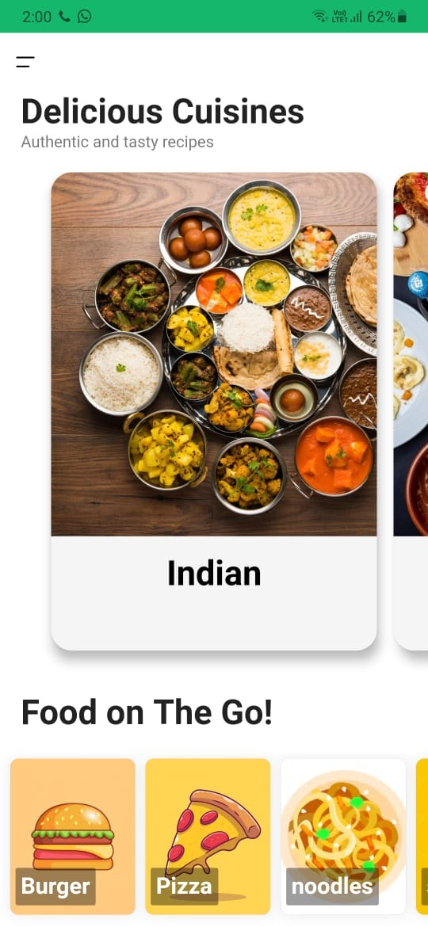
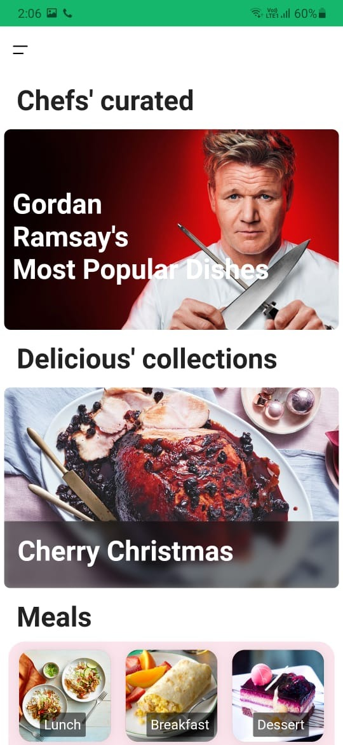
RESULTS
App interface(i)
App interface(i)

Slide 13
FUTUTRE SCOPE
As a future work, I am planning to persist in developing more mobile apps and entering deeply the world of Android development. Recetté has helped me to gain a lot of development skills and enrich my background, as I spent the previous 4 months searching for every tiny detail that concerns the development of android application. Thankfully, I have built a good knowledge.
Therefore, any upcoming project of mobile application development will undoubtedly be within my reach. In addition, as to the future of Recipe Organizer, I will deploy it in Google PlayStore and update the app from time to time if necessary. I will export my database soon, and then buying an account in Google PlayStore to publish the app. Also, I will monetize my application using Admob.

Slide 14






CONCLUSION
So by using this application users can cook different recipes at their home.
They can also manage their diet.
They can manage their time.

Slide 15
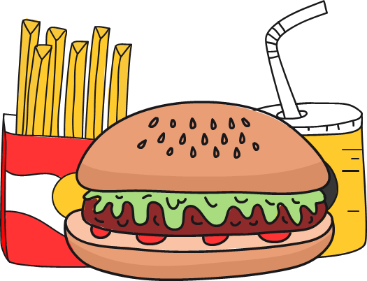
THANKYOU

